Slide 1
Cryptocurrency

Slide 2

From Where to buy Cryptocurrency

Slide 3
Types of Exchanges
Centralized Exchanges
Decentralized Exchanges

Slide 4
Centralized Exchanges
Binance
Bitget
OKX
Bybit
Coinbase etc

Slide 5
Decentralized Exchanges
Uniswap (Ethereum Blockchain)
PancakeSwap (Binance Smart Chain)
Trader Joe (Avalanche)
Raydium (Solana)

Slide 6
Activity
Creation of Binance Account
Overview of Binance Platform
Binance Web3 Wallet vs Binance Custodial Wallet
Adding Funds to Binance
Selling Funds through Binance

Slide 7
Market Structure and Order Types

Slide 8
Trading
Buying and Selling of Cryptocurrency
Types of Trading
Spot Trading
Futures Trading

Slide 9
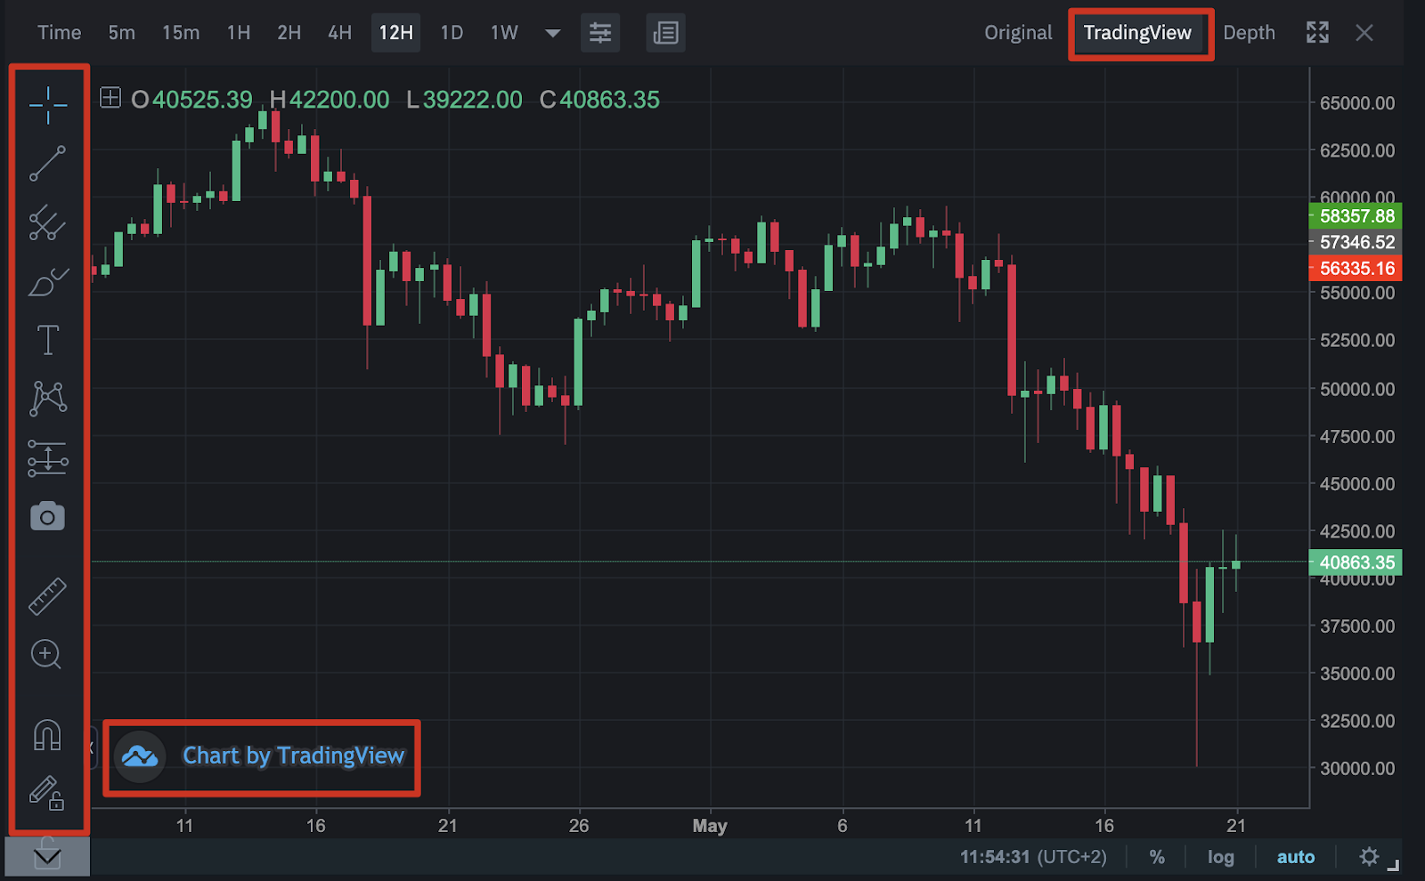
Spot Trading
Buy currency when the price is Low
Sell it when the price is high
E.g. Gold

Slide 10
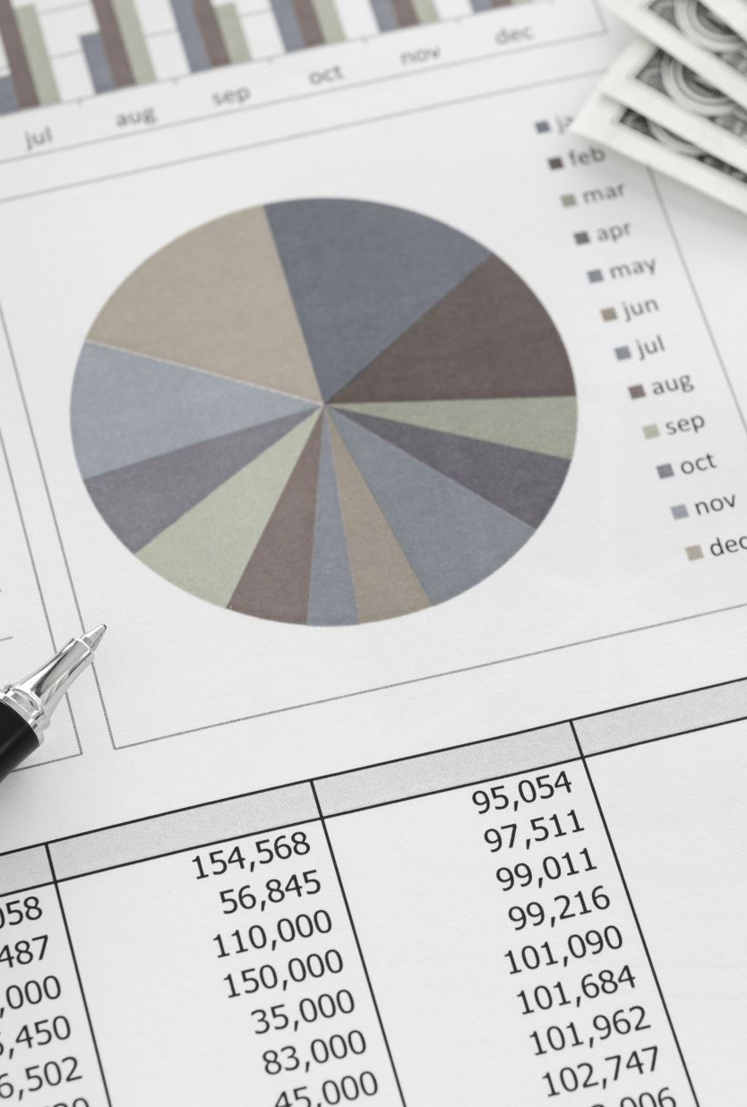
Why does the price go Up or Down?

Slide 11
SPOT TRADING DEMO
Deposit and Withdraw Funds
Buy and sell Cryptocurrency
Trading Fee

Slide 12

Future Trading
Traders can bet on the long and short positions with leverages
Long → Bet that the price will go up (Pump)
Short → Bet that the price will go down (Dump)

Slide 13
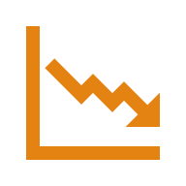
FUTURE TRADING DEMO
Taking Long and Short Positions
Margin Modes
Isolated
Cross
Leverage
Liquidation
Set Take Profit/ Stop Loss (TPSL)

Slide 14
Order Types
Market Order
Limit Order
Take-Profit Order
Stop-Loss Order
Stop-Limit Order

Slide 15
Liquidity
How easily and quickly an asset (like BTC) can be bought or sold at stable prices without causing significant price movement.
Fast Transactions – Easy entry/exit.
Price Stability – Prevents large swings.
Lower Slippage – Minimal difference between expected and executed price.

Slide 16
Slippage
Difference between the expected price of a trade and the actual executed price
Why Does Slippage Happen?
Low Liquidity – Not enough buyers/sellers at desired price.
High Volatility – Prices change rapidly during execution.
Large Orders – Big trades move the market price.

Slide 17

Activity
Mock Trading Both Spot and Future
Notes:
Market Risk: Price volatility, liquidity issues.
Operational Risk: Exchange hacks, wallet failures, key mismanagement.
Regulatory Risk: Sudden bans or compliance requirements.
Technology Risk: Smart contract bugs, protocol failures.
Reputation Risk: Scams, rug pulls.

Slide 18
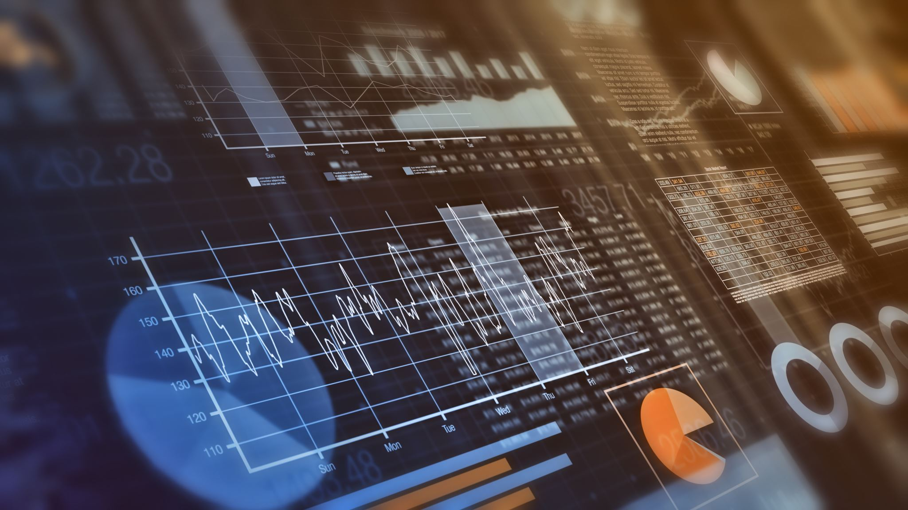
Introduction to Fundamental, Technical and Sentiment Analysis

Slide 19
Fundamental Analysis
Tokenomics
Utility & Use Case
Developer Activity
Team & Backers
Adoption & Network Growth
Ecosystem Strength
Roadmap & Milestones
Regulations & Security
Platforms
Market Cap (CoinMarketCap)
Whales activity (CoinGlass)
Glassnode (Glassnode)
Tokenomist (Tokenomist)
Whitepapers to study etc.

Slide 20
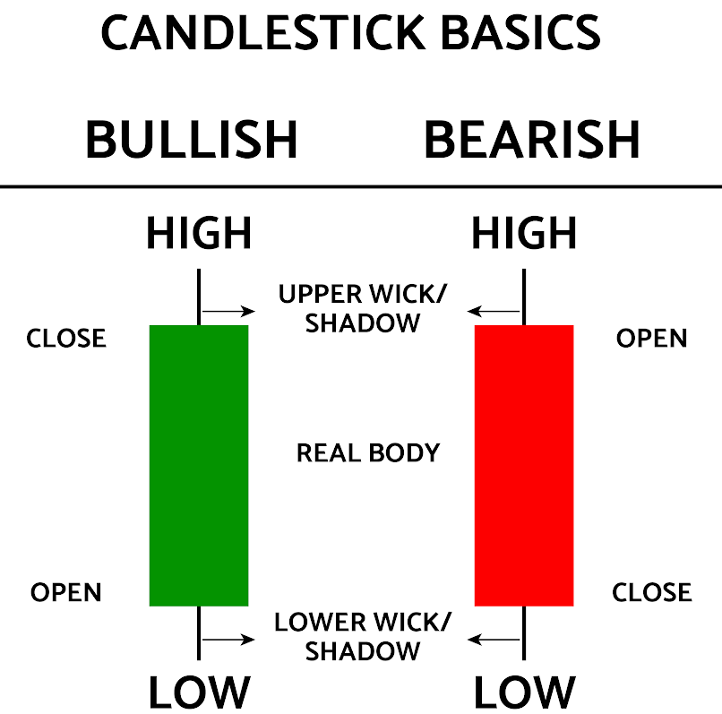
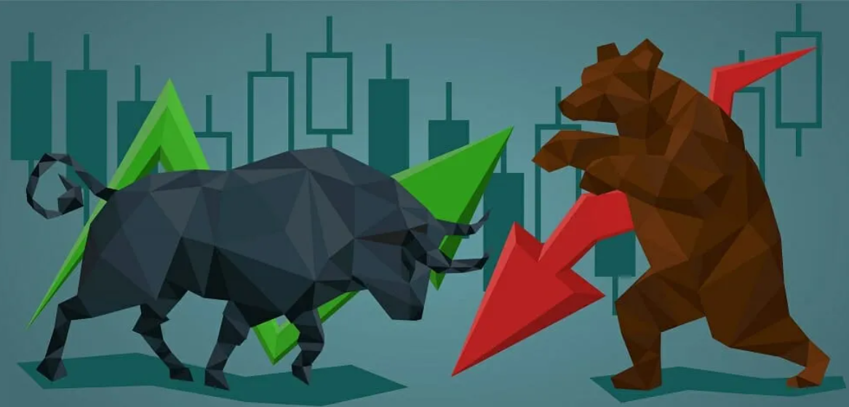
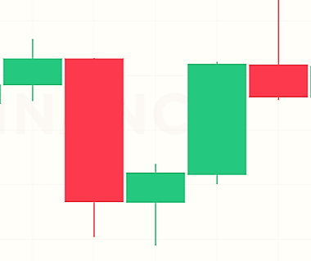
Reading Candlesticks Pattern

Slide 21
Trends
Bullish Trend
Bearish Trend
Sideways

Slide 22
Market Analysis
Technical Analysis
Sentiment Analysis

Slide 23
Technical Indicators
Price
Volume
Open Interest (OI)
OI Notion Value (OI NV)
RSI
Support and Resistance
Liquidation Chart
Funding Rate
MA
Fear and Greed
Long/short ratio
Orderbook

Slide 24
Activity
Pick a coin and perform Fundamental Analysis

